Slide 1
students-ai.com
Q-Hack 2025
Enabling life-long learners to achieve more

Slide 2








The Problem
?
Gregor Mihelac, Xufei Yang, Andrei Prioteasa, Shivam Suchak, Tim Hirndorf | Q-Hack 2025 | Estudent

Slide 3
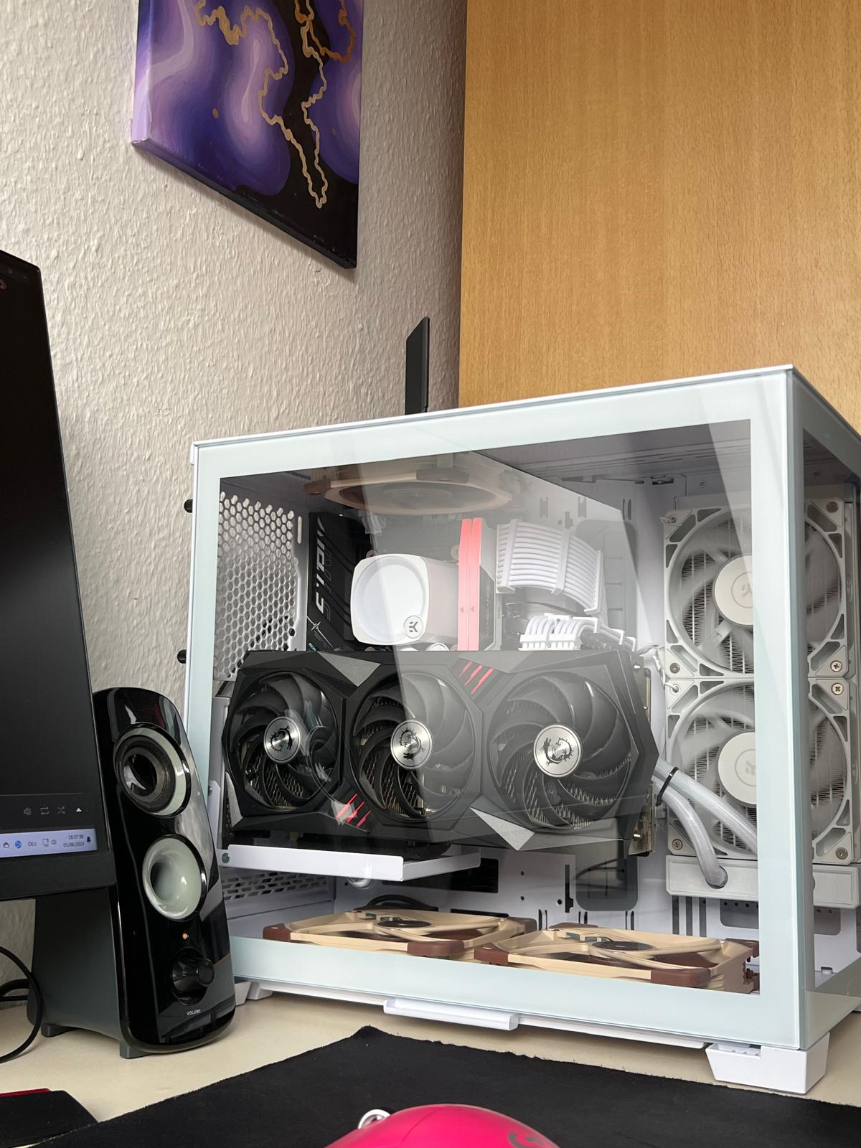
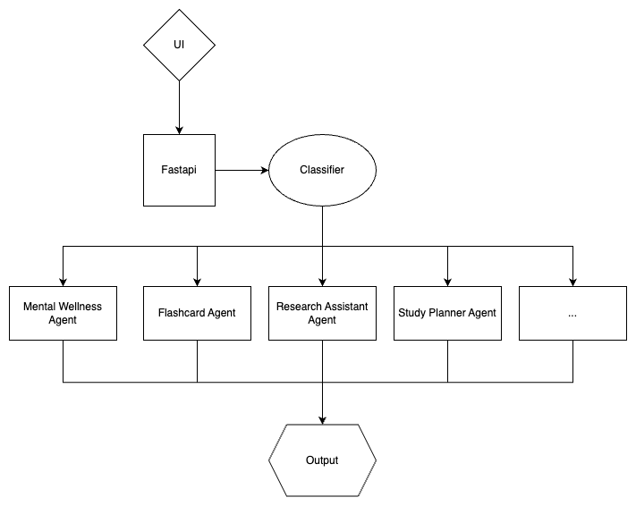
The Solution
Gregor Mihelac, Xufei Yang, Andrei Prioteasa, Shivam Suchak, Tim Hirndorf | Q-Hack 2025 | Estudent

Slide 4
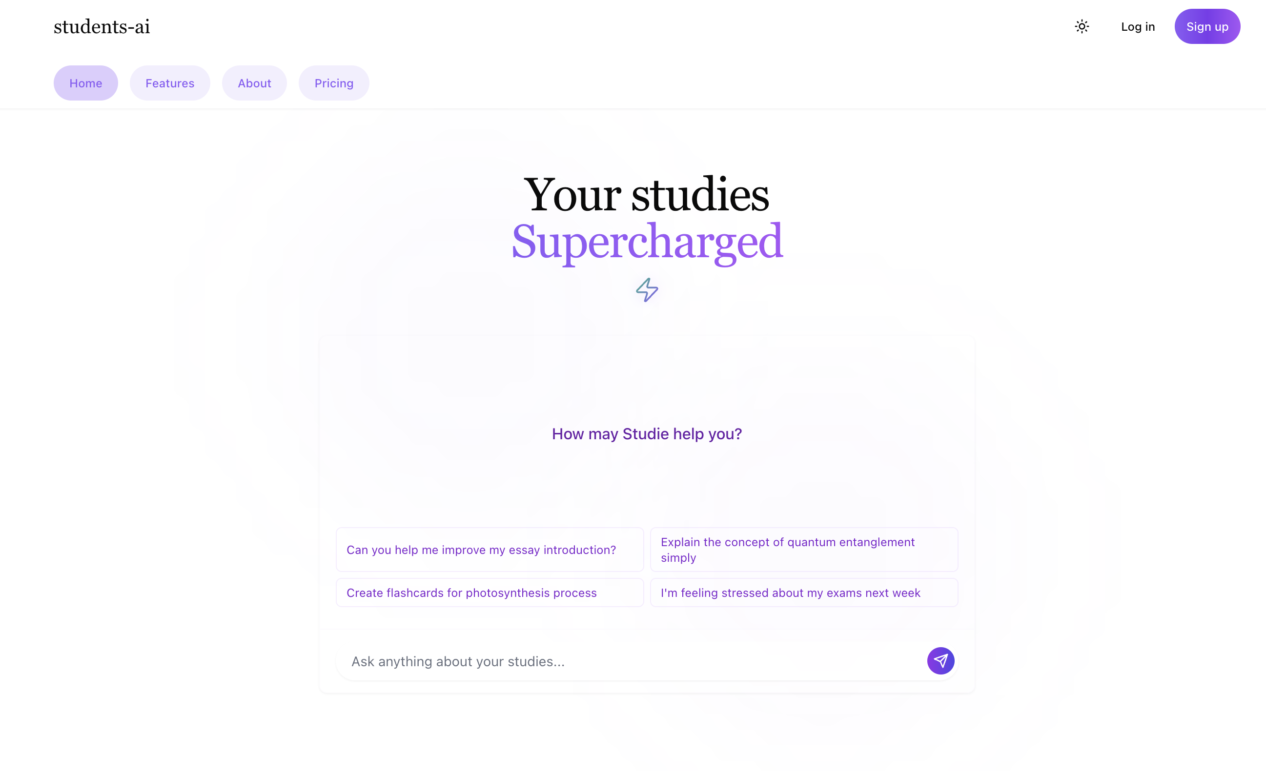
Gregor Mihelac, Xufei Yang, Andrei Prioteasa, Shivam Suchak, Tim Hirndorf | Q-Hack 2025 | Estudent

Slide 5
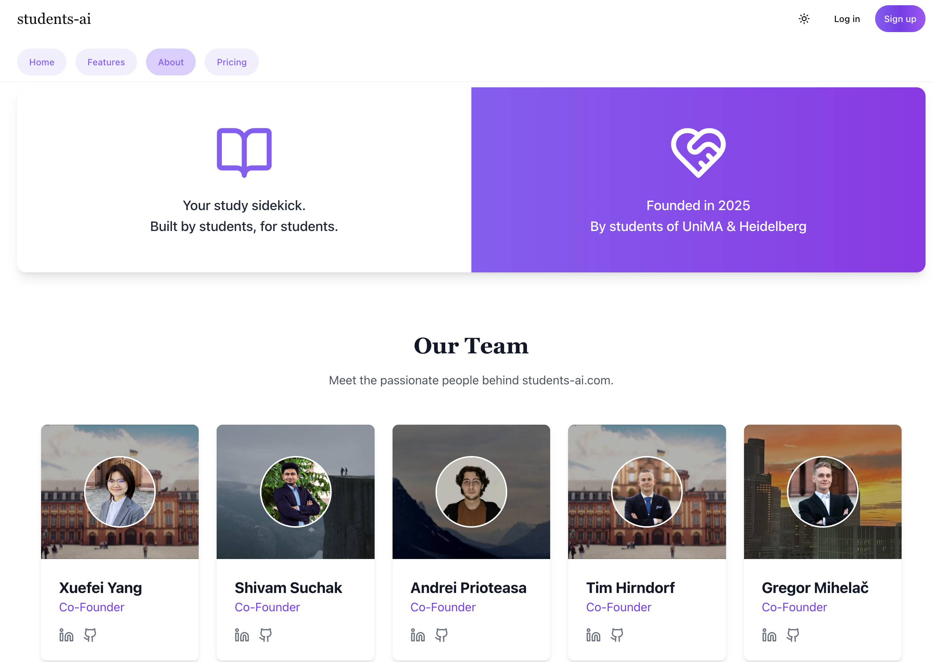
Gregor Mihelac, Xufei Yang, Andrei Prioteasa, Shivam Suchak, Tim Hirndorf | Q-Hack 2025 | Estudent

Slide 6
Gregor Mihelac, Xufei Yang, Andrei Prioteasa, Shivam Suchak, Tim Hirndorf | Q-Hack 2025 | Estudent

Slide 7
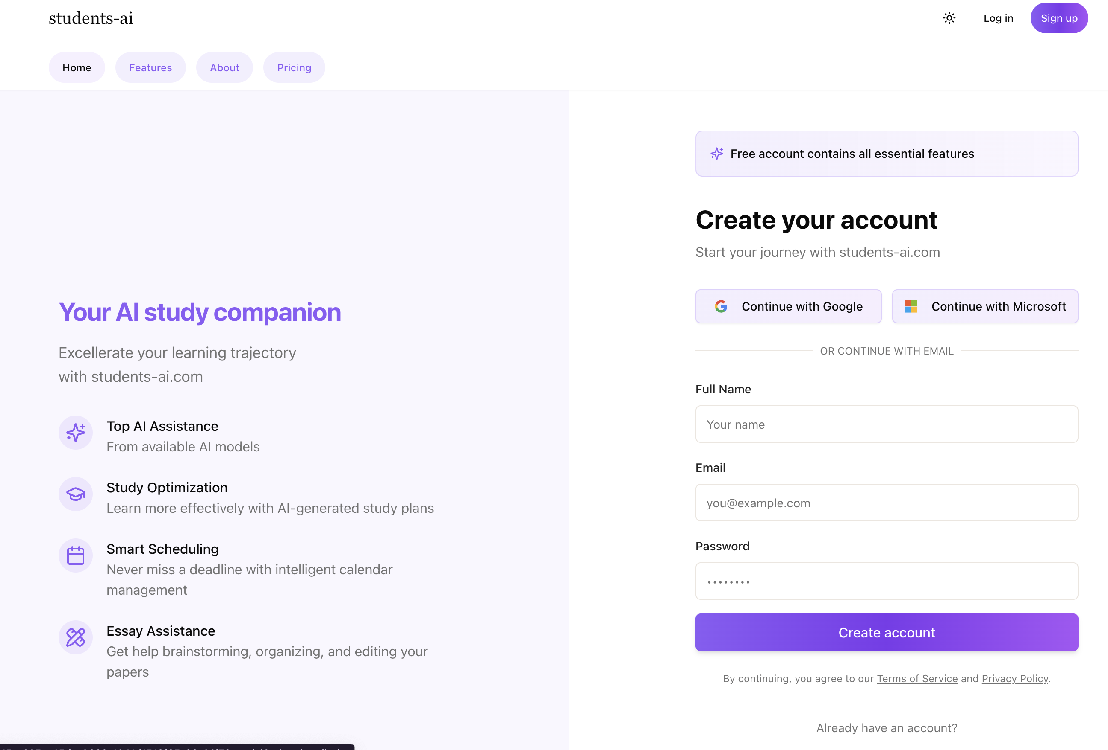
Gregor Mihelac, Xufei Yang, Andrei Prioteasa, Shivam Suchak, Tim Hirndorf | Q-Hack 2025 | Estudent

Slide 8
W E ARE ONLINE
https://students-ai.com
Gregor Mihelac, Xufei Yang, Andrei Prioteasa, Shivam Suchak, Tim Hirndorf | Q-Hack 2025 | Estudent

Slide 9

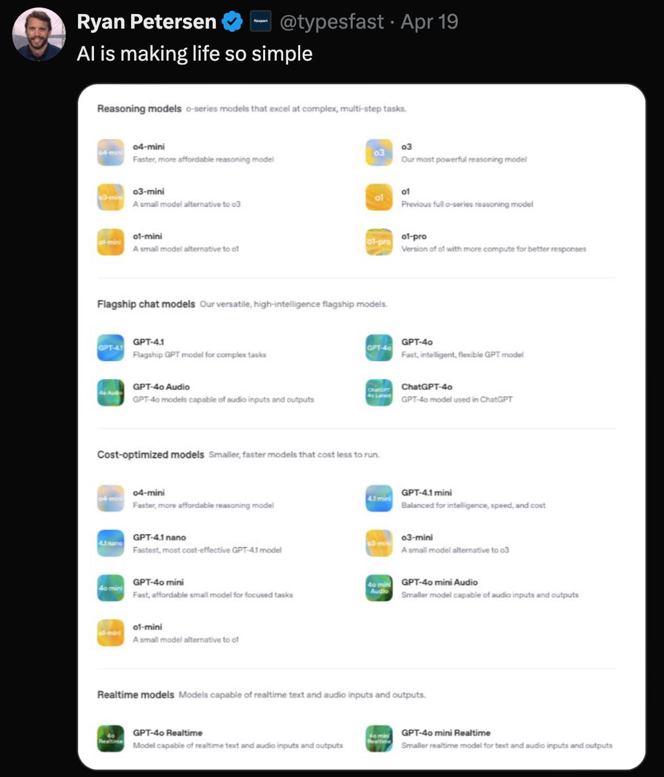
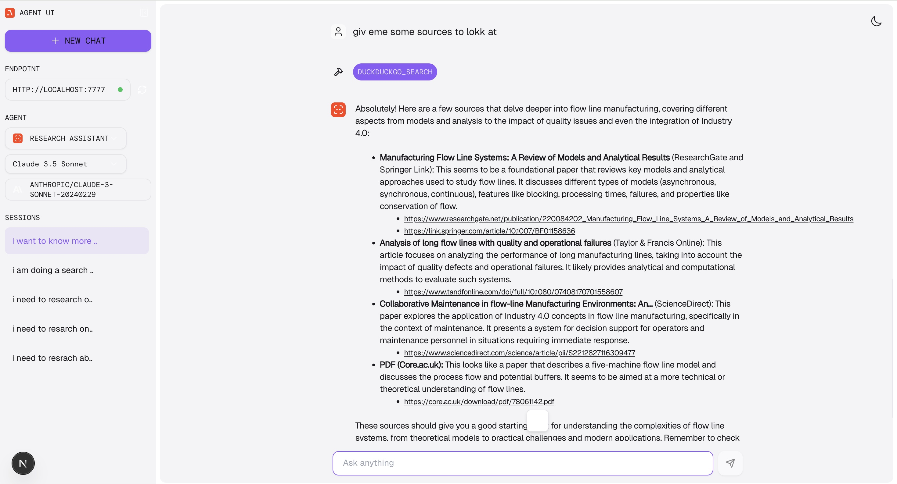
The Solution
Gregor Mihelac, Xufei Yang, Andrei Prioteasa, Shivam Suchak, Tim Hirndorf | Q-Hack 2025 | Estudent

Slide 10
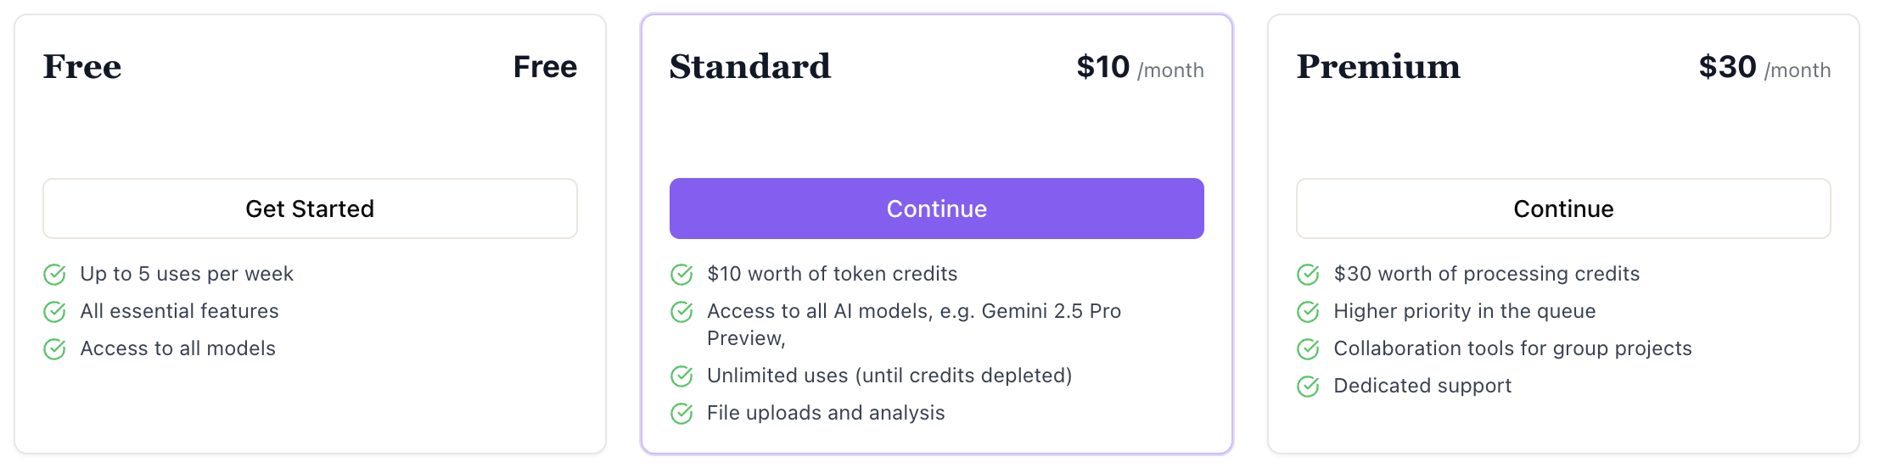
The Solution - Pricing
What do we offer for that?
Pay as you go API
curl -X POST https://api.students-ai.com/ -H "Content-Type: application/json" -H "Authorization: qhack-ms" -d '{"prompt": "Help me create flashcards for the parts of a cell."}'
Gregor Mihelac, Xufei Yang, Andrei Prioteasa, Shivam Suchak, Tim Hirndorf | Q-Hack 2025 | Estudent

Slide 11



Our Future
1
2
3
Gain Traction
Expand Reach
Create Value
Gregor Mihelac, Xufei Yang, Andrei Prioteasa, Shivam Suchak, Tim Hirndorf | Q-Hack 2025 | Estudent

Slide 12
Thank you!
Students-ai.com
Q-Hack 2025
Enabling life-long learners to achieve more
Gregor Mihelac, Xufei Yang, Andrei Prioteasa, Shivam Suchak, Tim Hirndorf | Q-Hack 2025 | Estudent

